Slide 1


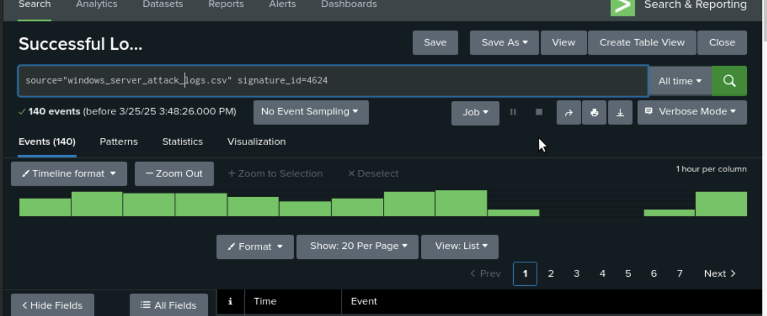
PROJECT 3 .
Splunk> Security
VSI SOC Team
By Adam Weiler, Azucena Cuarezma, Bill Strahlend, Dante Griffin, Michael Lee, Neil Ortiz

Slide 2
Table of Contents
This document contains an Overview
Monitoring Environment
Attack Analysis
Project Summary & Future Mitigations
VSI and its security concerns
Introduction to Splunk as a monitoring tool
Installation of Splunk Enterprise Security Content
Log sources: Windows Server & Apache Server
Overview of the cyberattack by JobeCorp
Examination of Windows attack logs
Examination of Apache attack logs
Key findings: Indicators of compromise (IOCs)
Effectiveness of the monitoring solution
Summary of monitoring results
Recommendations for improving VSI’s security
Future mitigations to strengthen defenses
Final thoughts and next steps
‹#›

Slide 3



Monitoring Environment
Splunk as a Monitoring Tool
Log Sources for Security Analysis
Splunk Add-Ons for Enhanced Monitoring
‹#›

Slide 4

Scenario
Project Scenario: Monitoring VSI’s Security with Splunk
Security Operations Center (SOC) analyst
Virtual Space Industries (VSI),
JobeCorp, might attempt cyberattacks to disrupt its operations.
We designed a custom monitoring solution using Splunk.
objective was to analyze logs, detect potential threats, and assess the effectiveness of the monitoring setup.
The key systems under observation included:
Windows Server – Hosts proprietary intellectual property related to VSI’s virtual-reality programs.
Apache Web Server – Serves as VSI’s public-facing website, vsi-company.com.

Slide 5

Splunk Add-Ons
‹#›

Slide 6

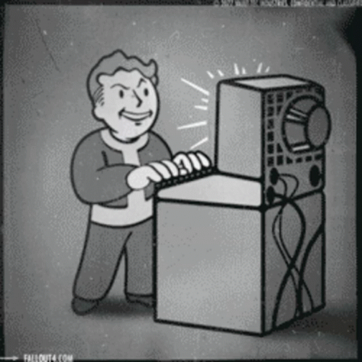

Splunk Enterprise Security Content Update
The update consists of tactics, techniques, and methodologies that help with detection, investigation, and response suggestions.
Enables security teams to directly implement detection searches, investigative searches, and other supporting details.
Contains easy-to-read background information with guidance, for key context on motivations and risks associated with attack techniques, as well as pragmatic advice on how to combat those techniques.

Slide 7
Splunk Enterprise Security Content Update
Scenario 1: Enhanced Threat Detection
A security analyst notices an increase in failed login attempts across multiple user accounts.
With the new Splunk Enterprise Security Content Update v5, they quickly deploy updated detection rules, identifying an attempt at credential stuffing. The new content update provides an immediate correlation between user behavior patterns and known attack techniques, allowing the analyst to block malicious access before any data is compromised.
Scenario 2: Streamlined Incident Response
Your facing a potential insider threat from a suspicious user accessing sensitive files late at night.
Thanks to the updated content in Splunk Enterprise Security Update v5, the security team is alerted instantly by advanced anomaly detection rules. The update provides context-driven insights, enabling a swift and informed response to contain the threat without unnecessary delays or manual investigation.

Slide 8
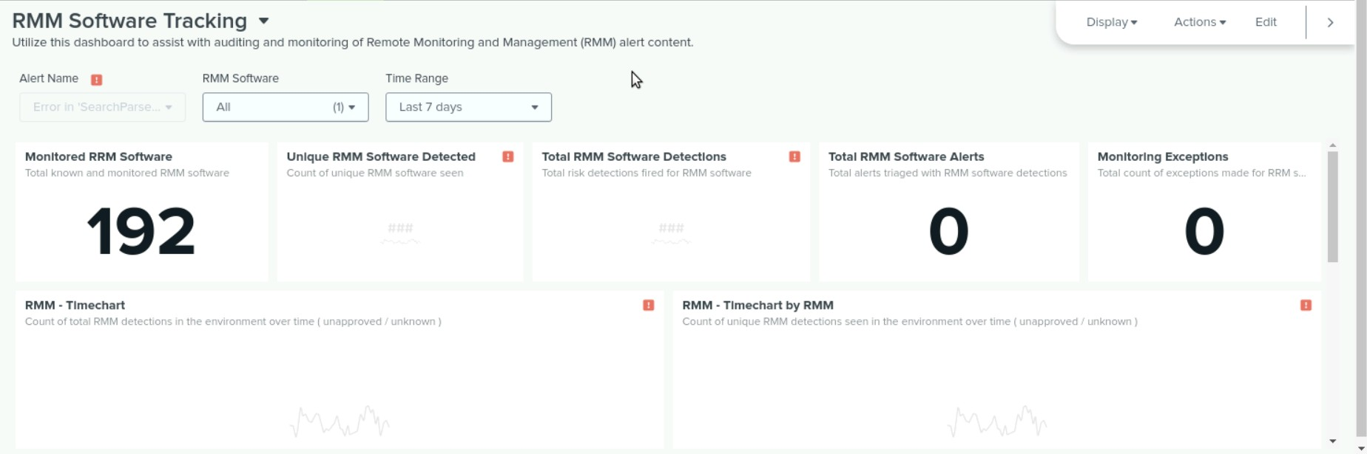
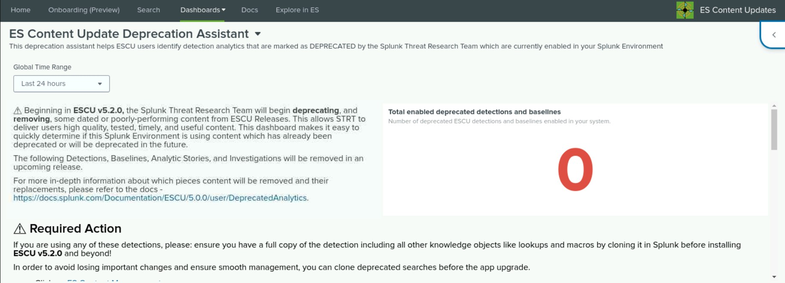
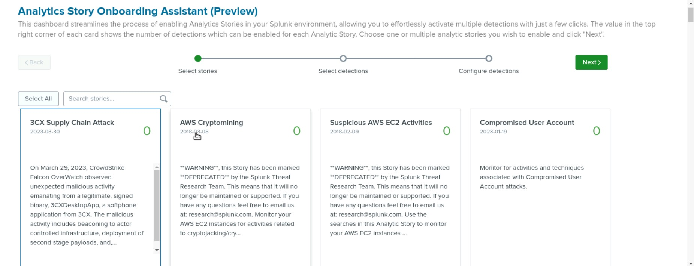

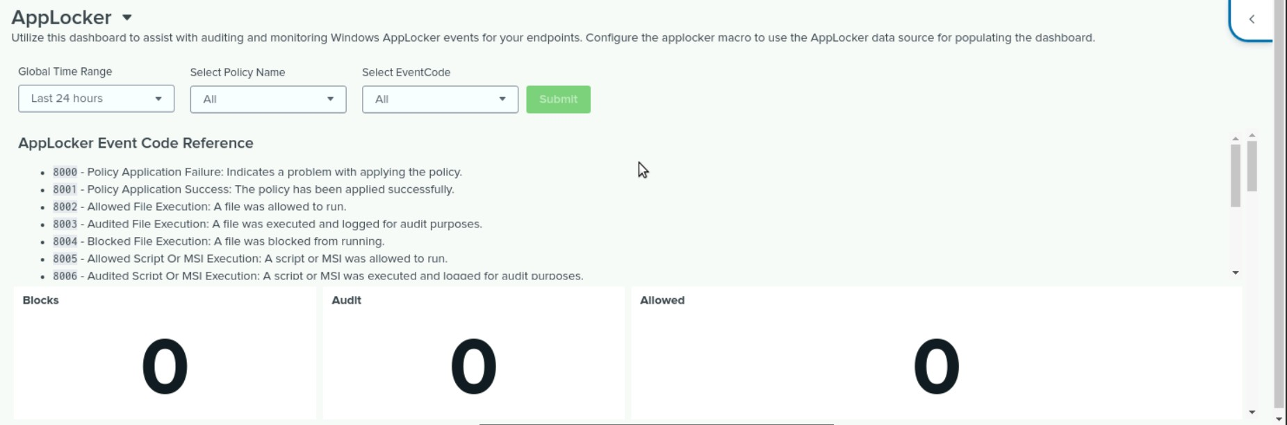
Splunk Enterprise Security Content Update

Slide 9
Logs Analyzed
Windows Logs
Apache Logs
1
2
Windows logs in Splunk typically contain various types of data related to system events, security events, application events, and more.
They typically contain a timestamp, event ID, source, user information, and a description of the event, which can be used for analysis and troubleshooting.
Apache logs in Splunk typically contain data related to web server activity like; IP Address', Timestamps, Request Methods, Request URL, HTTP Status Code, User Agent, Referrer and many more.

Slide 10
Windows Logs
‹#›

Slide 11
Reports—Windows
Designed the following reports:
Report Name | Report Description
Signature Activity Snapshot Report | A table providing key metrics to understand activities on the Windows system. These metrics included, Signature ID, Signature Description, Username, Activity Status, and Severity Level.
Unique Signature ID Report | A table providing a legend for the Unique Signature IDs that populated in the system.

Slide 12
Reports—Windows
Designed the following reports:
Report Name | Report Description
Severity Levels Comparison Report | A table providing statistical data comparisons between active Severity Levels with regard to how many times they populated and their percentage values compared to the rest.
Activity Status Comparison Report | A table giving statistical data comparisons on Activity Status displaying the difference between Success and Failure Activity with both quantity and percentage comparisons.

Slide 13
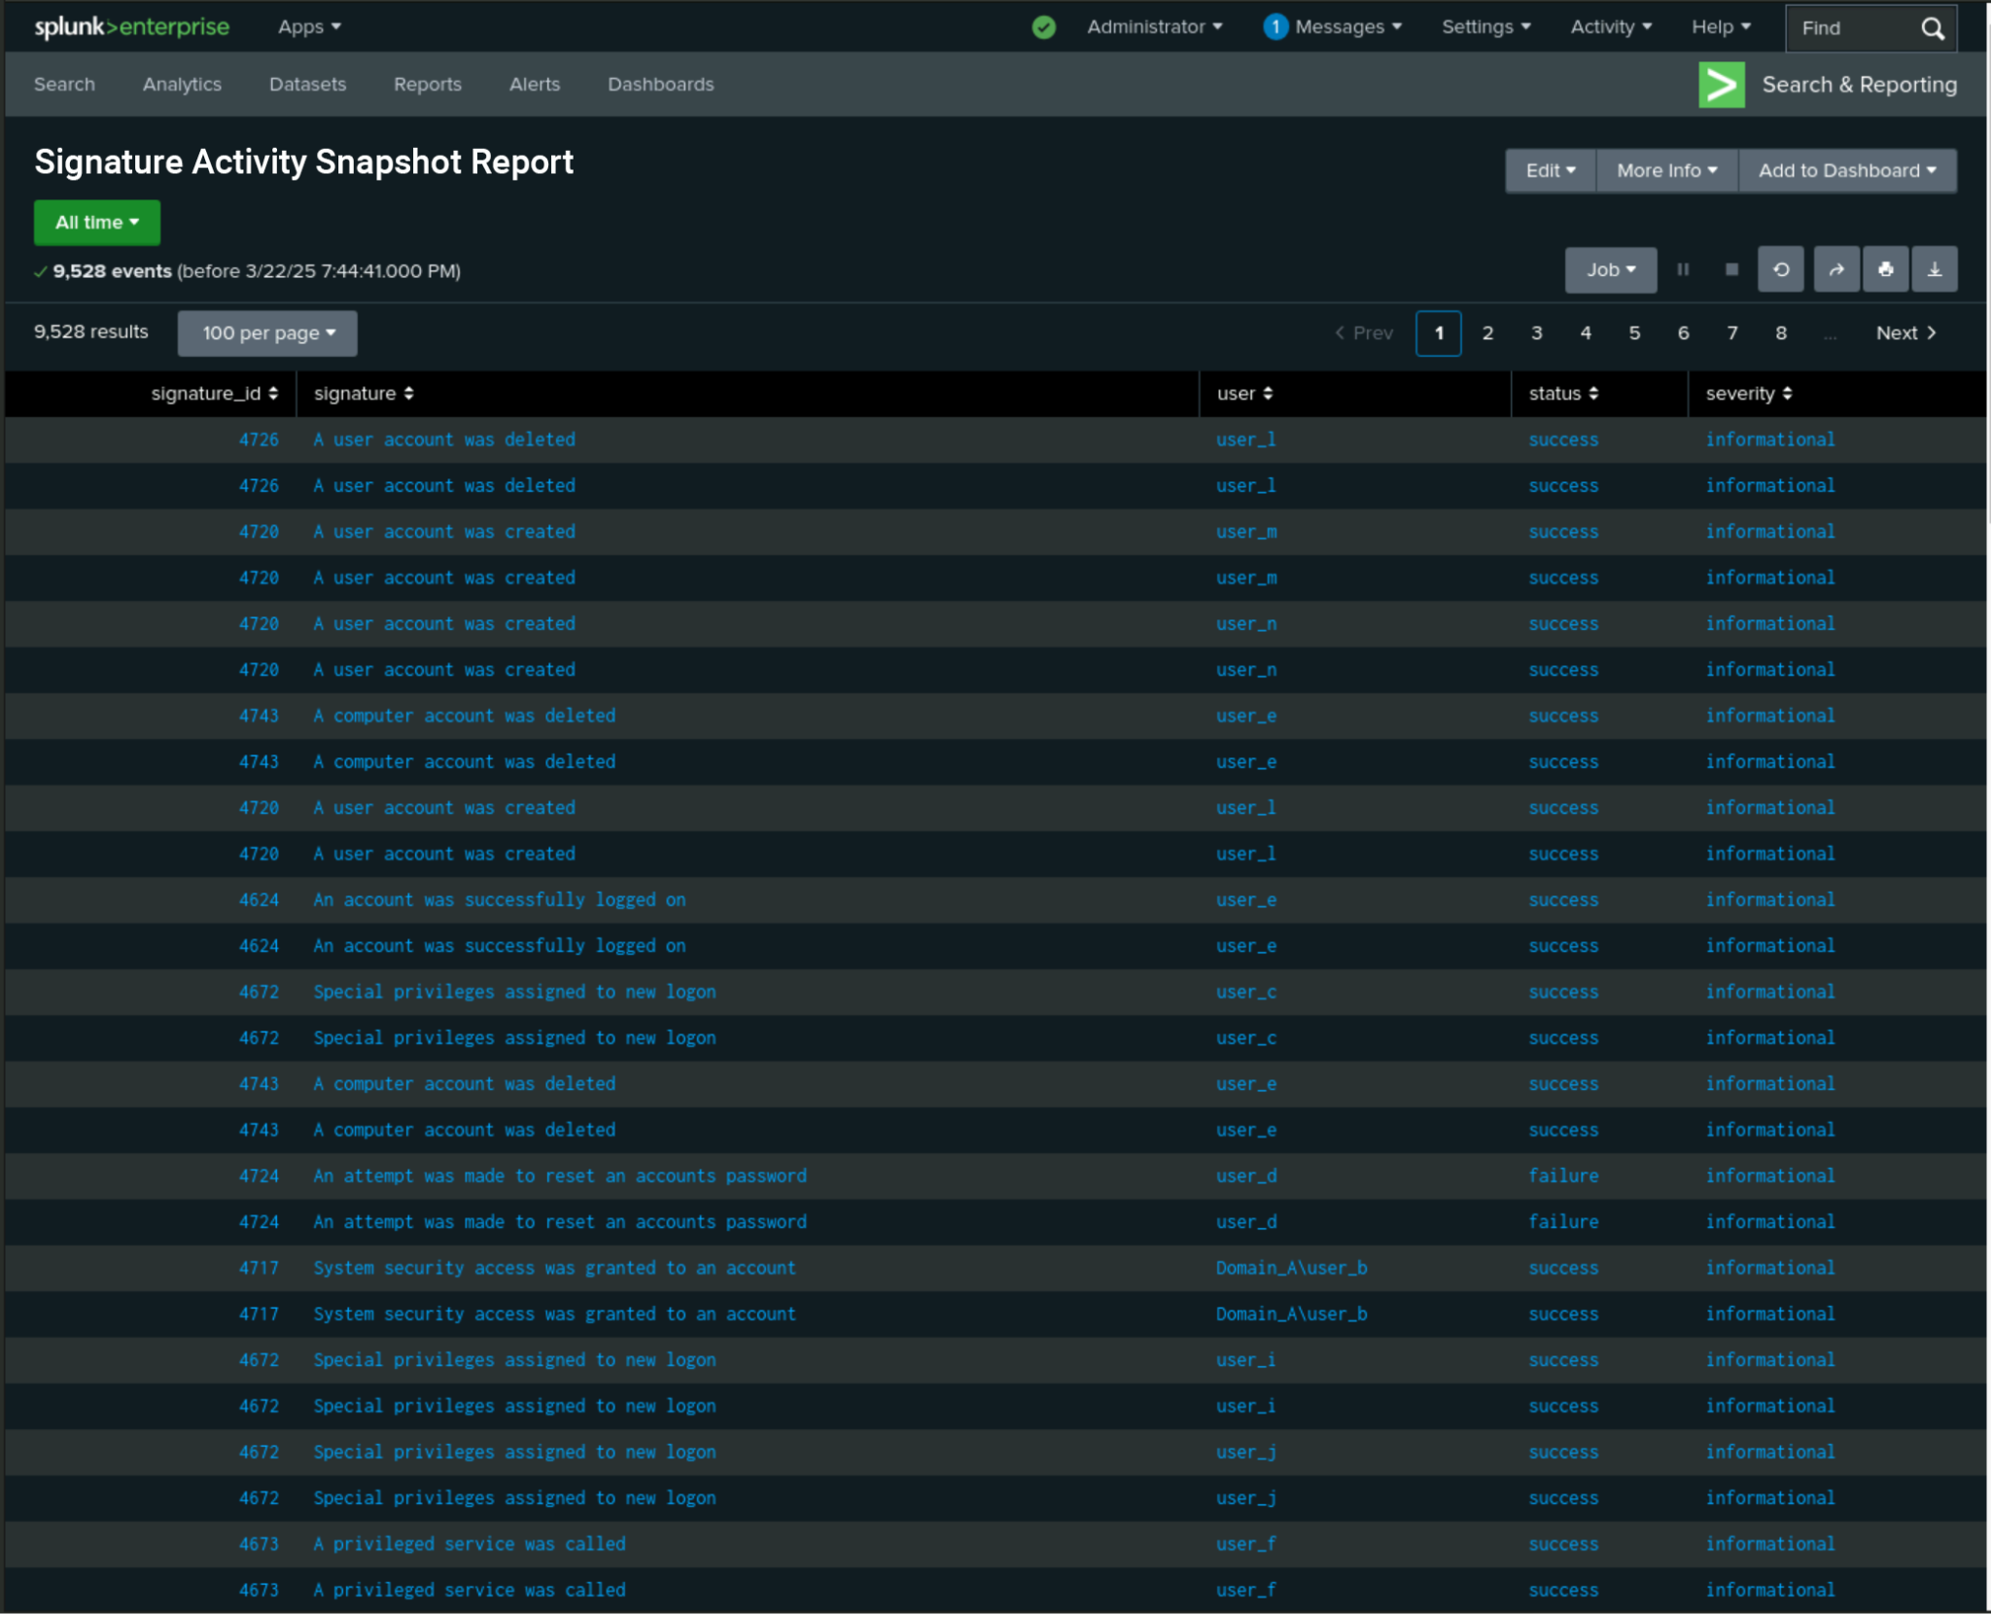
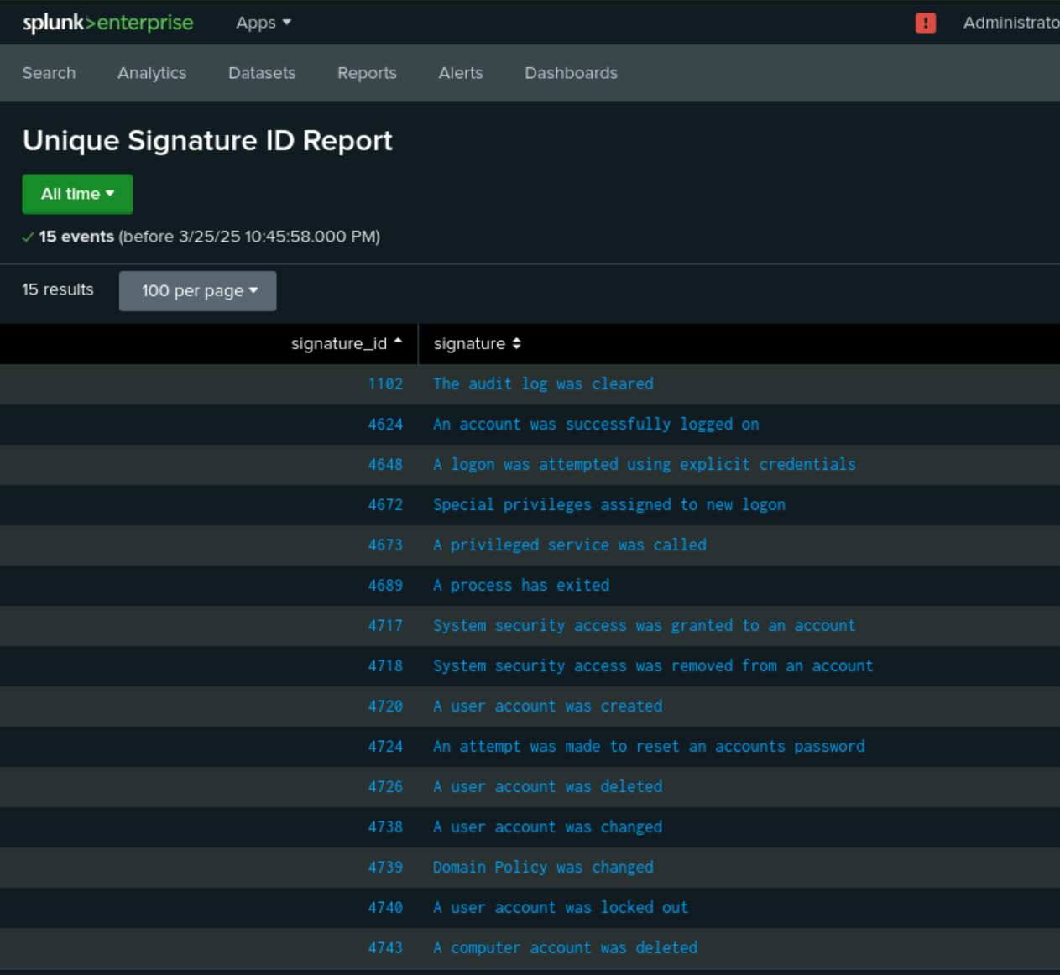
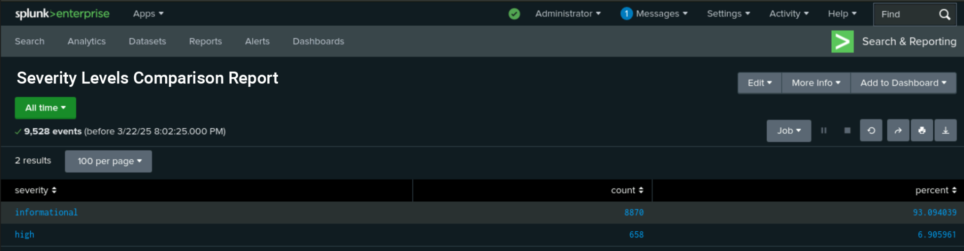
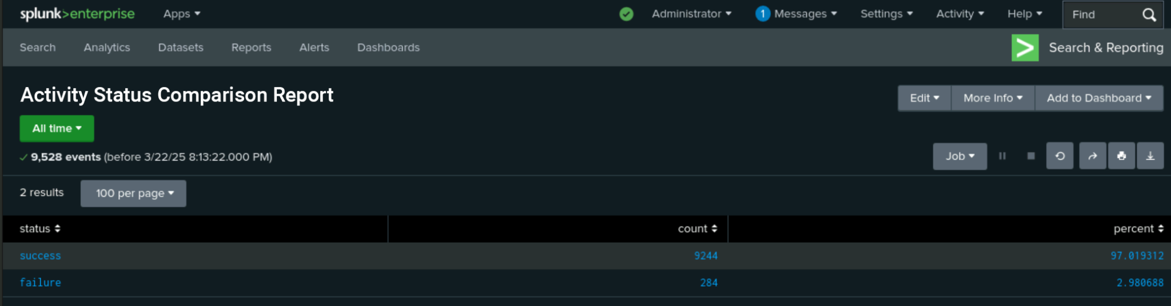
Images of Reports—Windows

Slide 14
Alerts—Windows
Designed the following alerts:
Alert Name | Alert Description | Alert Baseline | Alert Threshold
Activity Status Failure > 30 | A conditional hourly alert notifying when Activity Status Failures exceed 30 within an hour. | 24 | 30
JUSTIFICATION: When establishing the baseline Activity Status Failures peaked at 40 and troughed at 8. The average was 23.667, providing a baseline of 24. Establishing a threshold of 30 provided a reasonable metric for a alerts.

Slide 15
Alerts—Windows
Designed the following alerts:
Alert Name | Alert Description | Alert Baseline | Alert Threshold
Successful Logins > 65 | A conditional hourly alert notifying when Successful Logins exceed 65 within an hour. | 54 | 65
JUSTIFICATION: When establishing the baseline Successful Logins peaked at 84 and troughed at 32. The average was 53.834, providing a baseline of 54. Establishing a threshold of 65 provided a reasonable metric for a alerts.

Slide 16
Alerts—Windows
Designed the following alerts:
Alert Name | Alert Description | Alert Baseline | Alert Threshold
User Accounts Deleted > 60 | A conditional hourly alert notifying when more than 60 user accounts have been deleted within an hour. | 57 | 60
JUSTIFICATION: When establishing the baseline User Accounts Deleted peaked at 68 and troughed at 36. The average was 56.667, providing a baseline of 57. Establishing a threshold of 60 provided a reasonable metric for a alerts and due the nature of the signature we decided to be a little more conservative with the threshold.

Slide 17
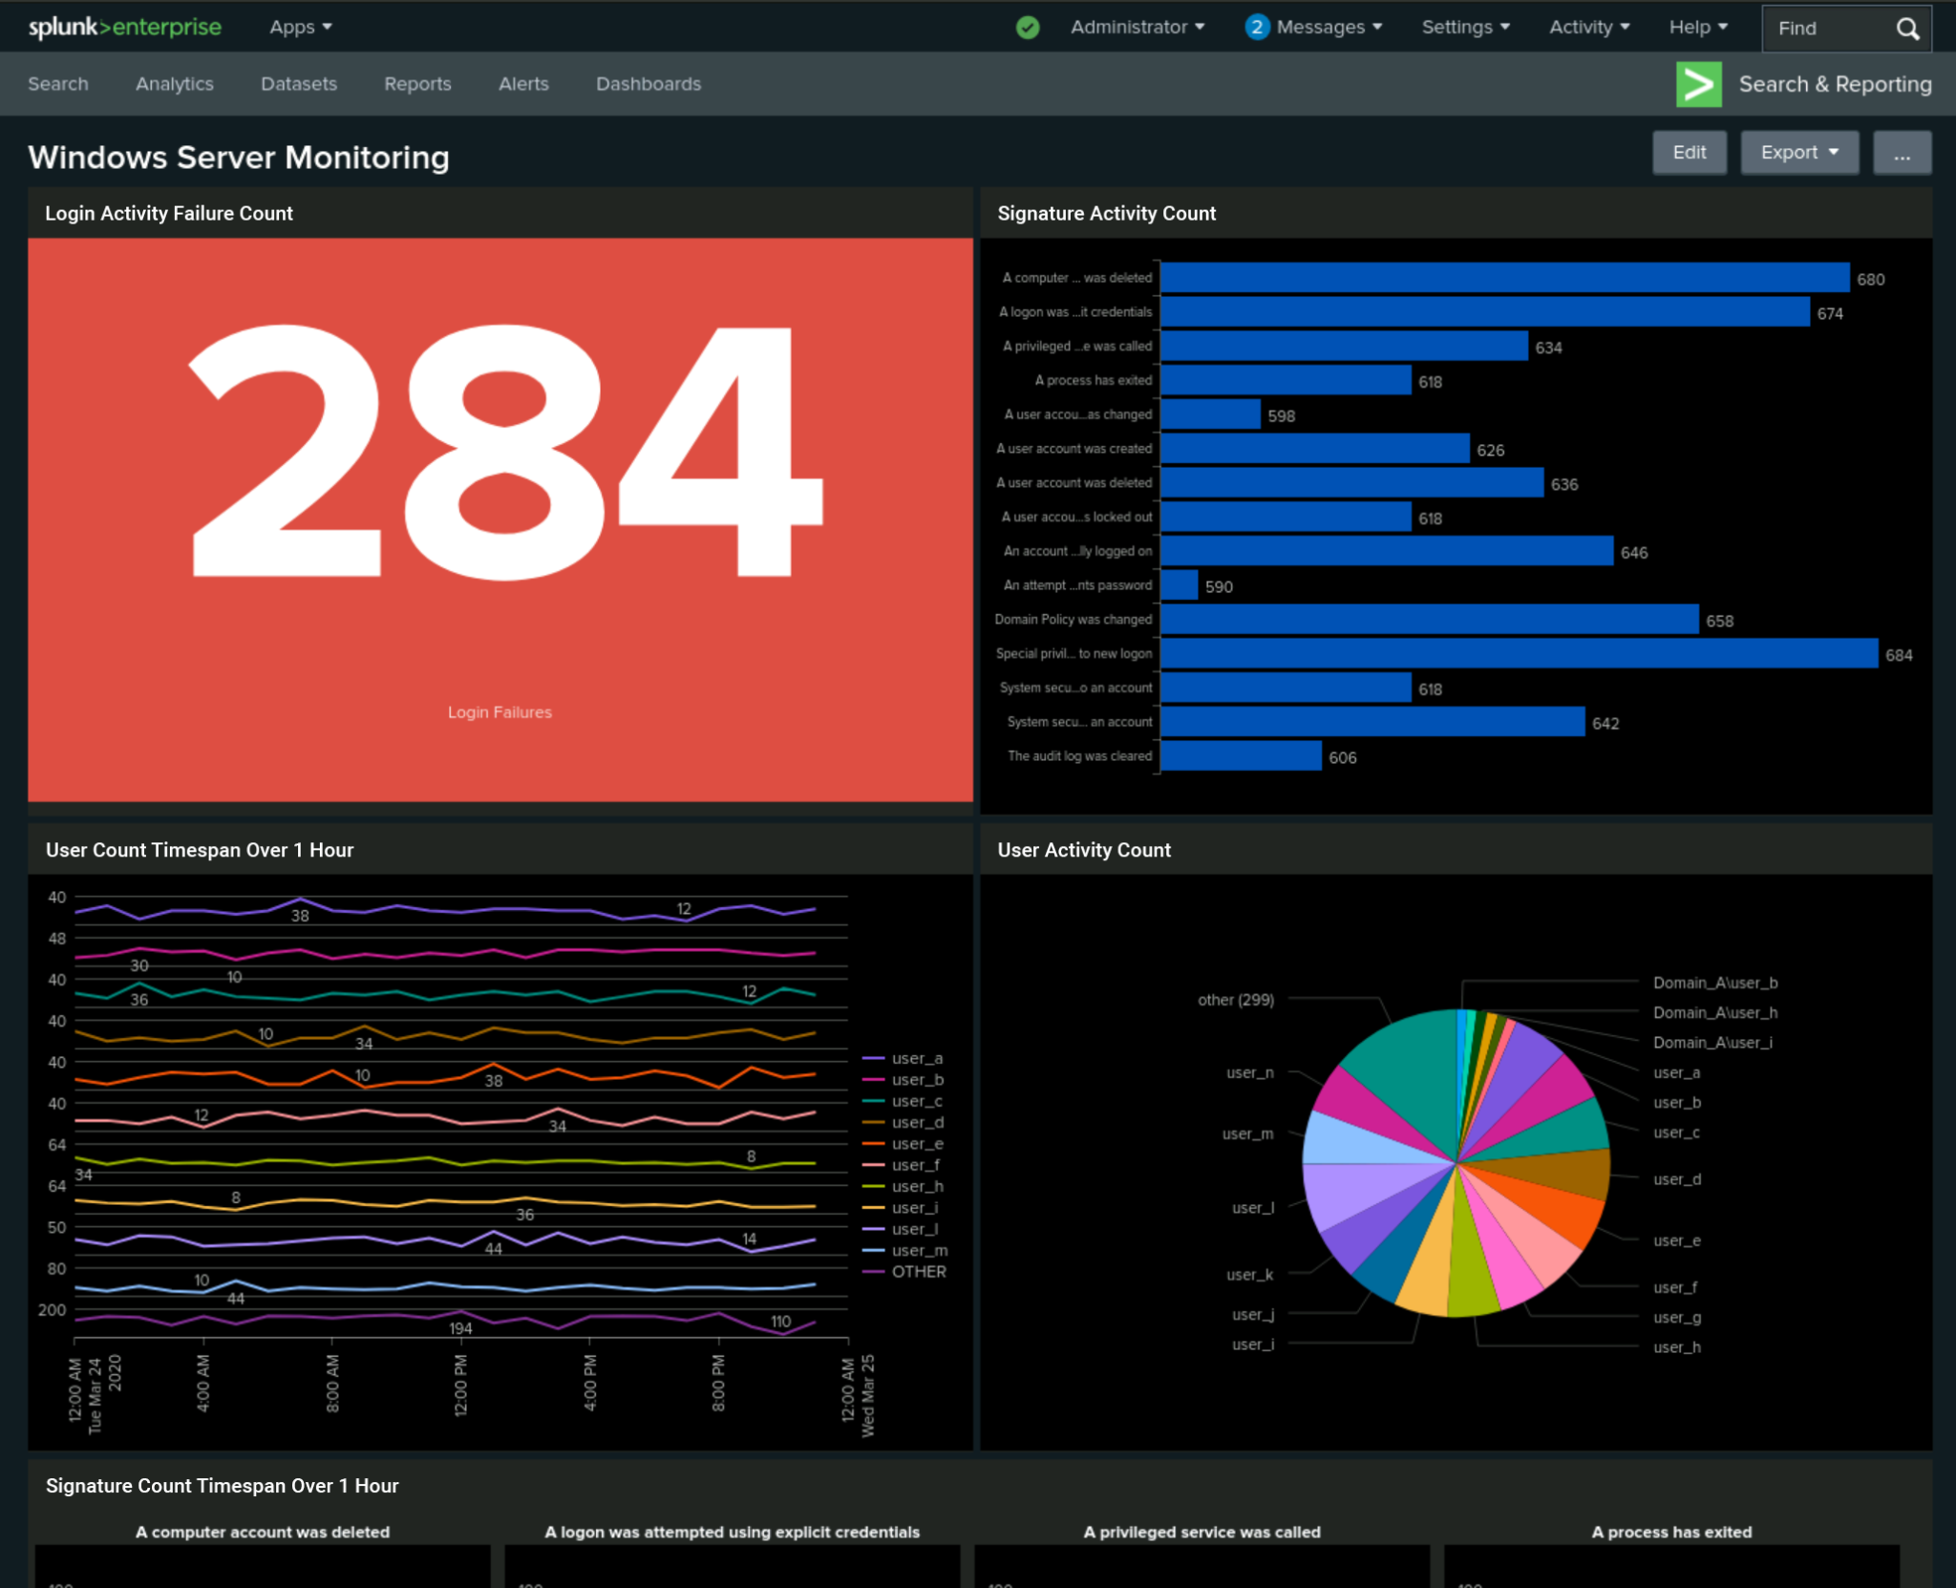
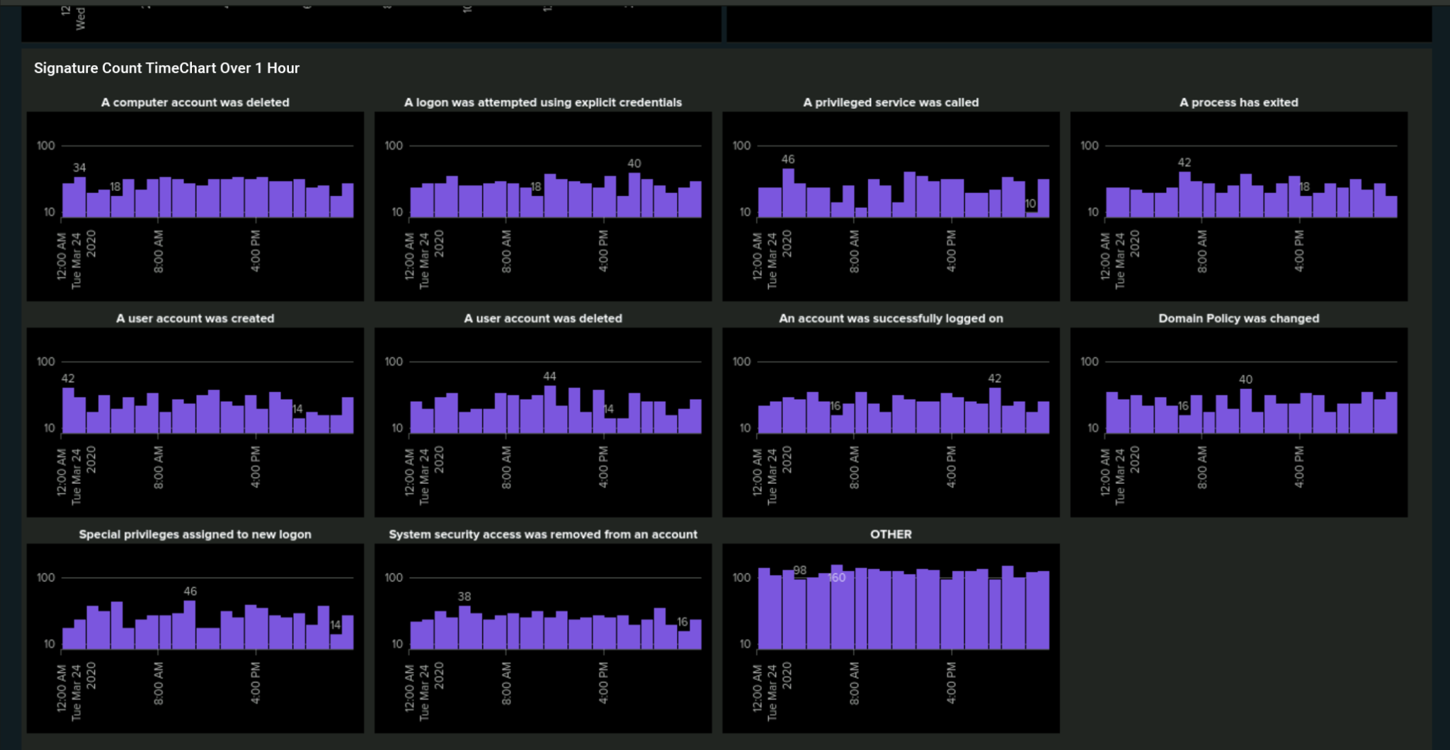
Dashboards—Windows

Slide 18
Apache Logs
‹#›

Slide 19
Apache Reports
Report Name | Report Description
Apache HTTP Methods | This report shows a table of the most used http methods
Apache HTTP Method Count | A report that shows the count of http methods
Apache Referer Domain | This report shows a table that displays the most frequented domains
Apache Hourly Usage | A time-based chart showing the hourly count of events from non-U.S. or unclassified IP addresses.

Slide 20
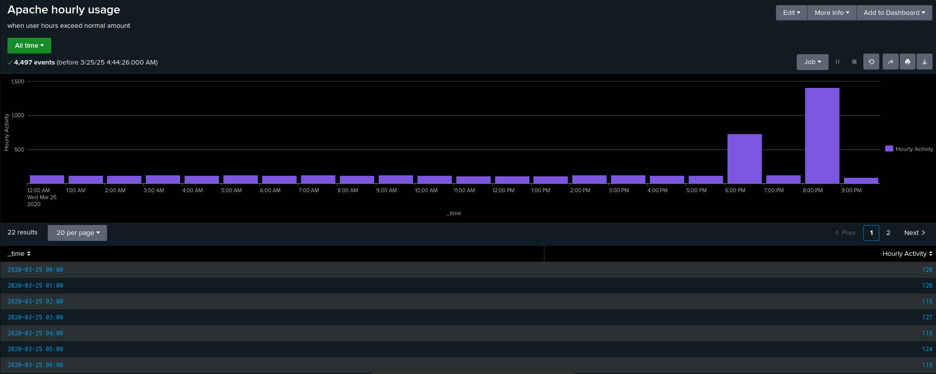
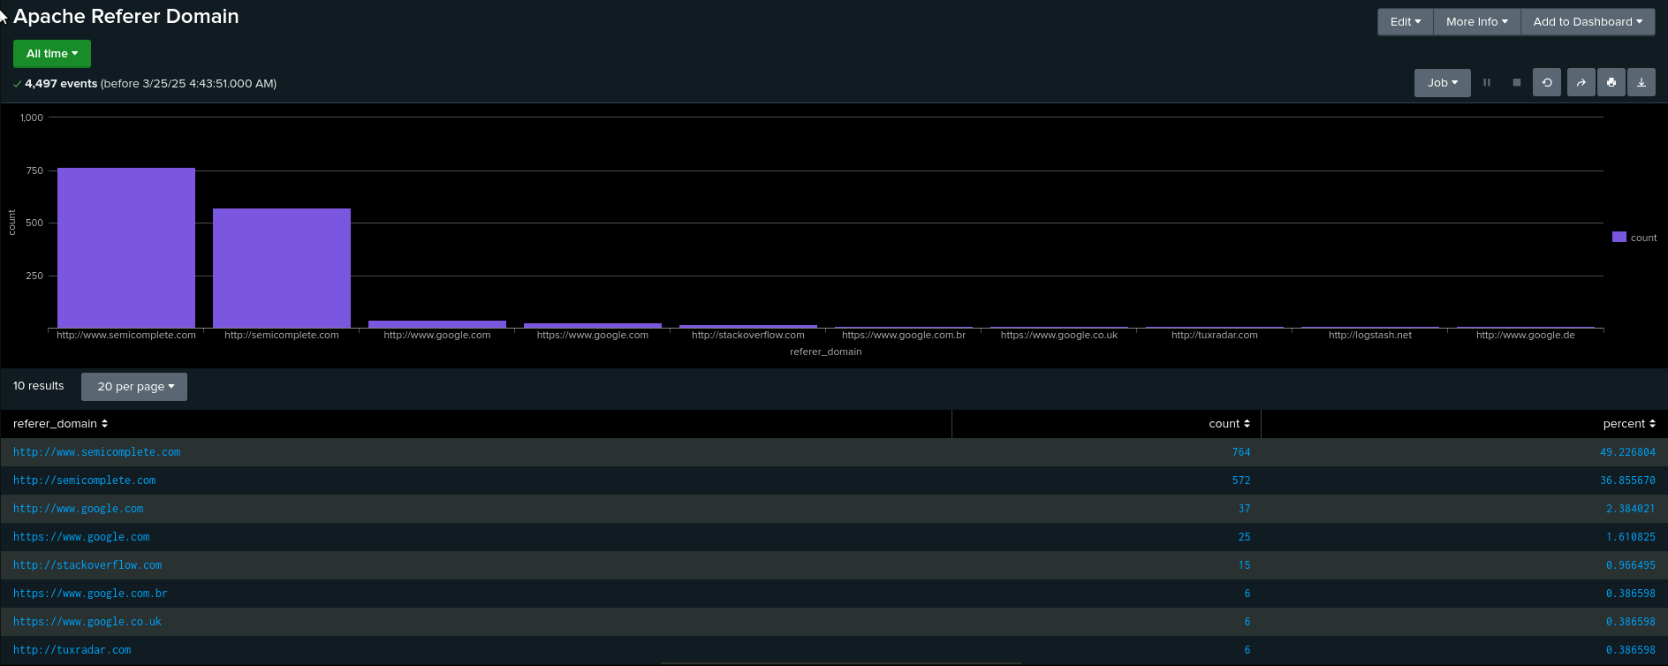
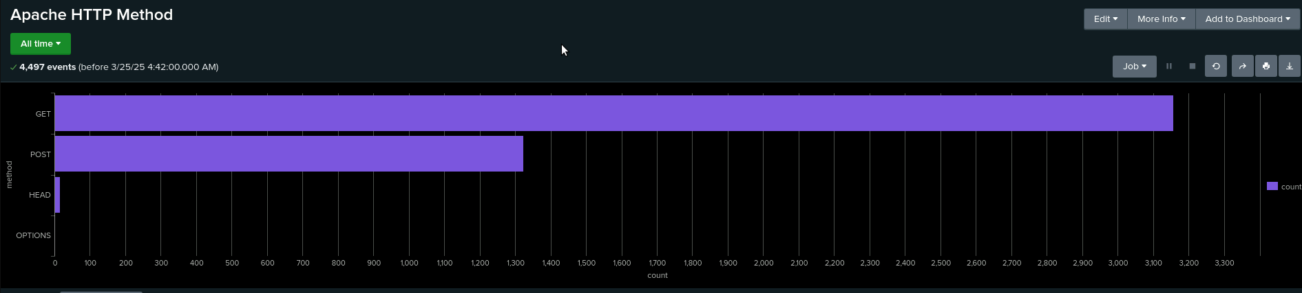
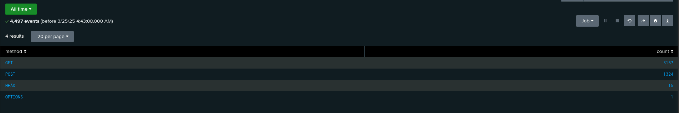
Apache Image Reports—Apache
Report Image
Report Image
Report Image
Report Image

Slide 21
Apache Alert 1
Designed the following alerts:
Alert Name | Alert Description | Alert Baseline | Alert Threshold
Hourly POST Alert | Alerts when POST methods have exceeded normal amount | 2 | 5
JUSTIFICATION: The reason why I chose my baseline and threshold was because normally there is 1-3 events per hour, and for the threshold being 5 is to help prevent false positives.

Slide 22
Apache Alert 2
Designed the following alerts:
Alert Name | Alert Description | Alert Baseline | Alert Threshold
International Hourly Usage Alert | Sends an alert when international hourly usage has exceeded normal amount | 120 | 134
JUSTIFICATION: Across the chart there were highs of 128 and lows of 112 so I went with the baseline of 120, 134 is a good threshold because it captures moderate spikes that are unusual but not so sensitive that small fluctuations within the normal range would trigger unnecessary alerts

Slide 23
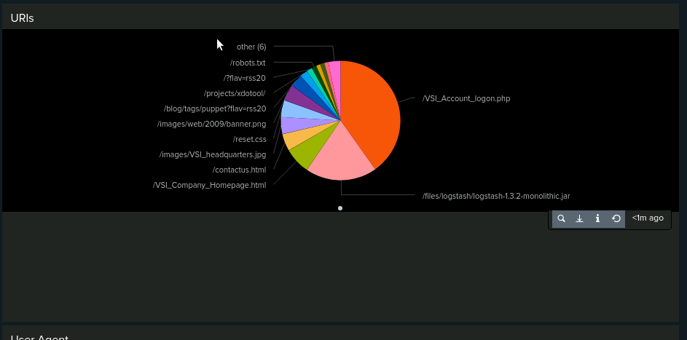
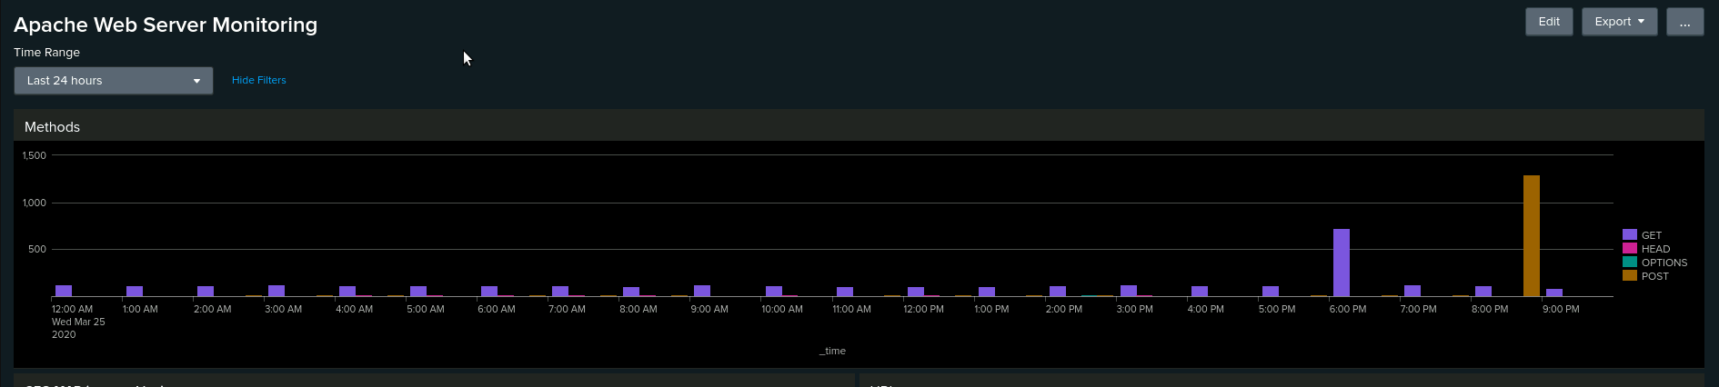
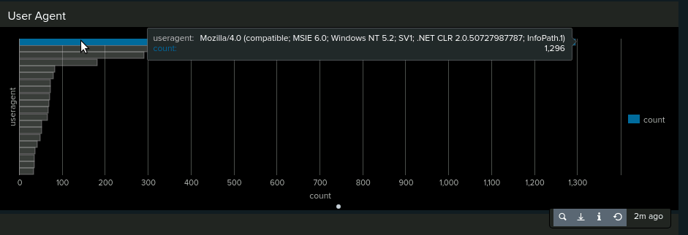
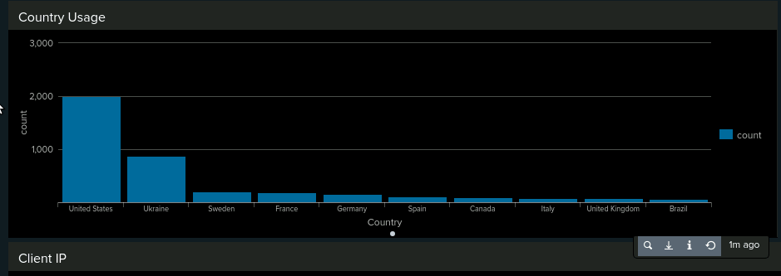
Apache Dashboard Images

Slide 24
Attack Analysis
‹#›

Slide 25
Attack Summary—Windows
Summarize your findings from your reports when analyzing the attack logs.
Severity Report:
- server_logs: Informational severity = 93%
- serverlogs : High severity = 7%
- attack_logs: Informational severity = 80%
- attack_logs: High severity =20%
Failed Activities Report:
- server_logs: success = 97%
- serverlogs : failure = 3%
- attack_logs: success= 98%
- attack_logs: failure =2%

Slide 26
Attack Summary—Windows
Summarize your findings from your alerts when analyzing the attack logs. Were the thresholds correct?
Failed Windows Activity:
Threshold set: 30 events
Alert!: 70 events between the hours of 8am-9am on 3/25/2025.
Successful Logon:
Threshold set: 65 events
Alert!: 392 events between the hours of 11am-12pm.
Primary user: user_j
Deleted Accounts:
Threshold set: 60 events
Alert!: No alert was set off.
Possible change of threshold needed ?

Slide 27
Attack Summary—Windows
Summarize your findings from your dashboards when analyzing the attack logs.
Dashboard analysis: Signatures
“an account was locked out”: (0100-0300)
Peak count 3584
“An attempt was made to reset an accounts password”: (0900-1100) Peak count is 3744
Dashboard analysis: Users
user_a: (0100-0300) peak count 3936 events
user_k: (0900-1100) peak count 5024 events

Slide 28
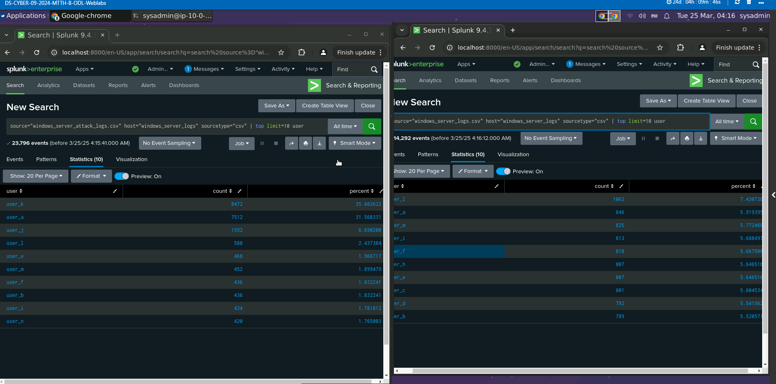
Screenshots of Attack Logs
Statistical User analysis.

Slide 29
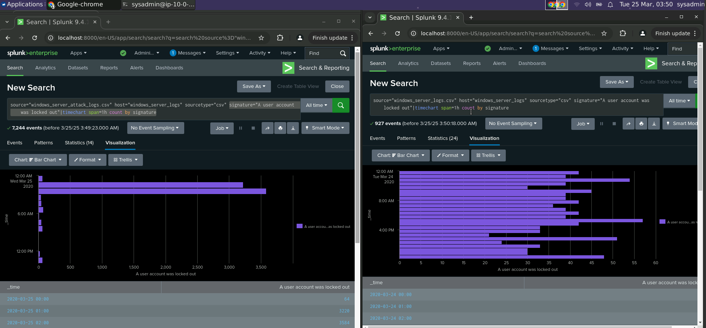
Screenshots of Attack Logs
Column chart for signature: “ A user account was locked out”

Slide 30
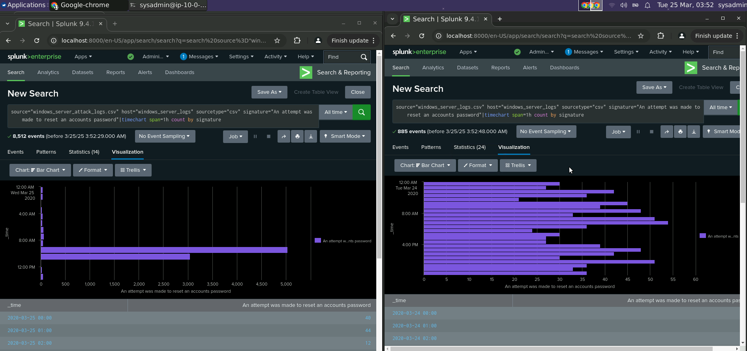
Screenshots of Attack Logs
Column Chart analysis for signature: An attempt was made to reset an accounts password”

Slide 31
Attack Summary—Apache
Summarize your findings from your reports when analyzing the attack logs.
Methods: 29% increase in POST activities while seeing about a 29% decrease in GET activities.
Referer Domains: There was no noticeable activities during the referrer domain during the attack.
HTTP Response Codes: Several minimal changes. With a 13% increase for response code 404.

Slide 32
Attack Summary—Apache
Summarize your findings from your alerts when analyzing the attack logs. Were the thresholds correct?
Post Activities:
Threshold: 5 events.
Alert!: 1296 events between the hours of 8pm - 9pm.
International Activity:
Threshold: 134 events.
Alert! 937 events between the hours of 8pm-9pm.

Slide 33
Attack Summary—Apache
Summarize your findings from your dashboards when analyzing the attack logs.
HTTP METHODS:
GET: (1700-1900) peak count 729 events
POST: (1900-2100) peak count 1296 events
CLUSTER MAP:
Kiev, Ukraine: 440 events
Kharkiv, Ukraine: 432 events
URI DATA:
“/files/logstash/logstash-1.3.2-monolithic.jar” : 624 events.
“/VSI_Account_logon.php” : 1296 events

Slide 34
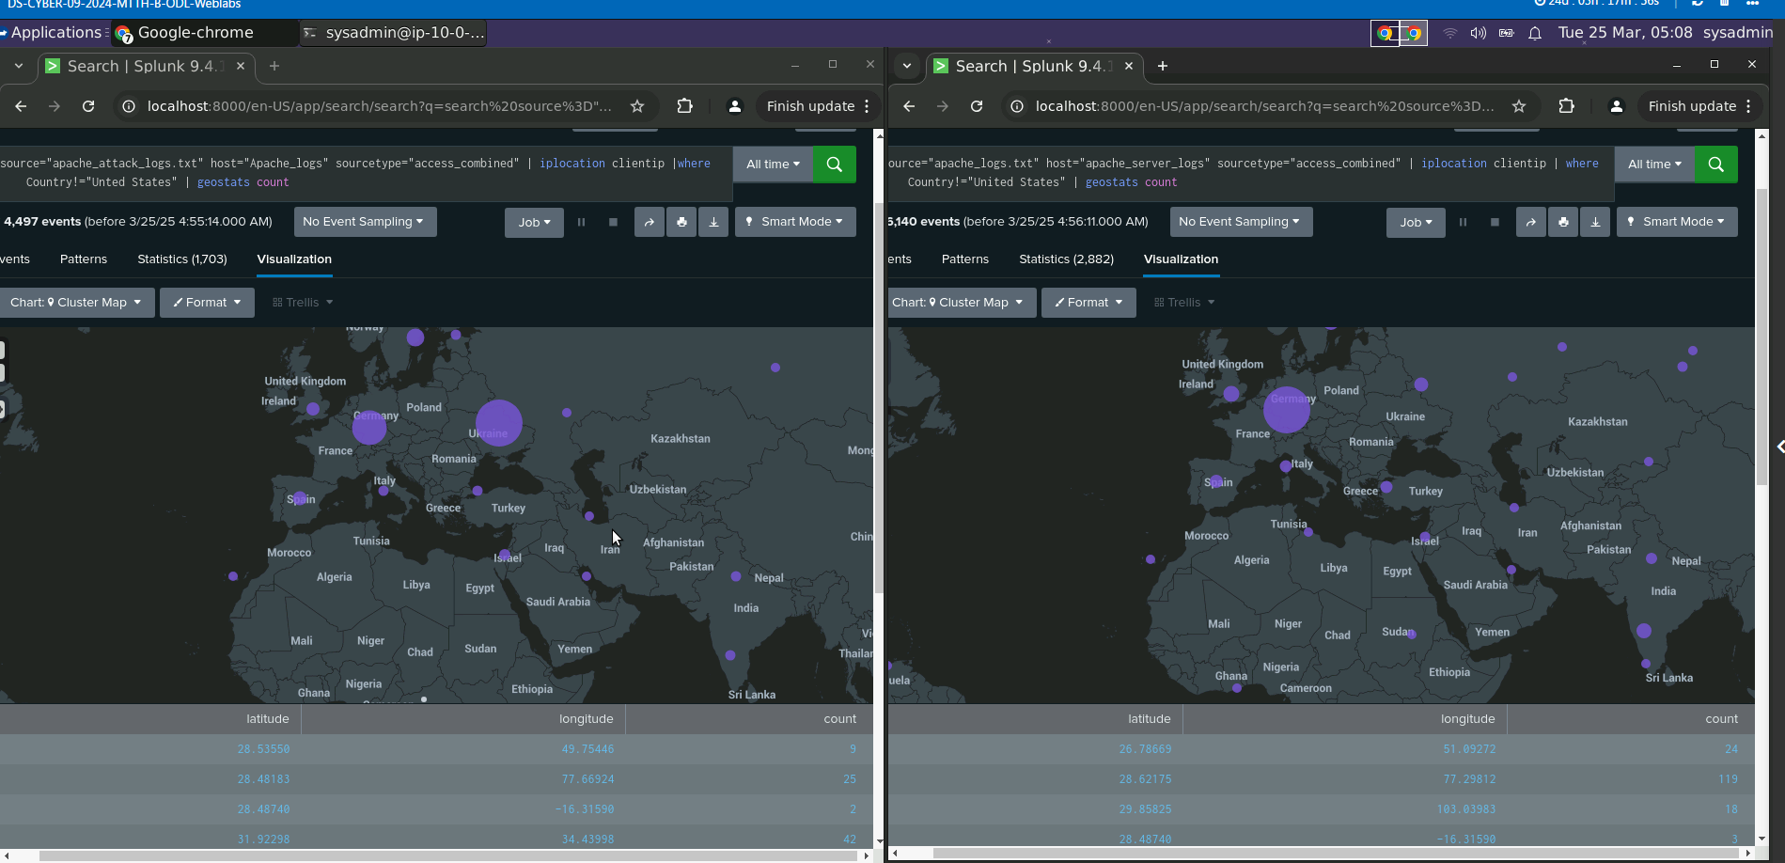
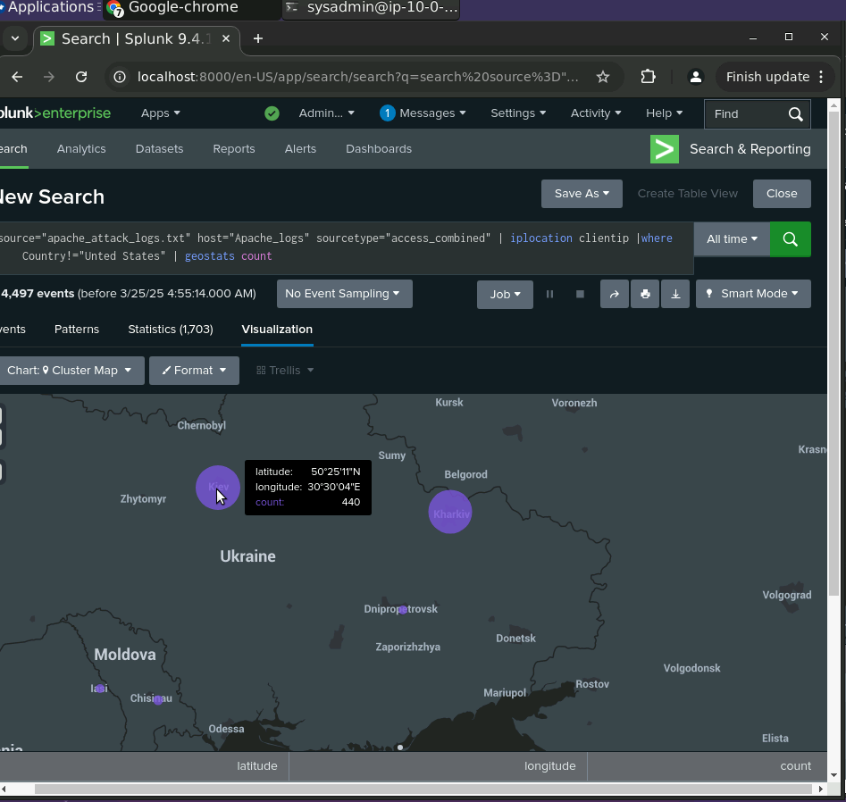
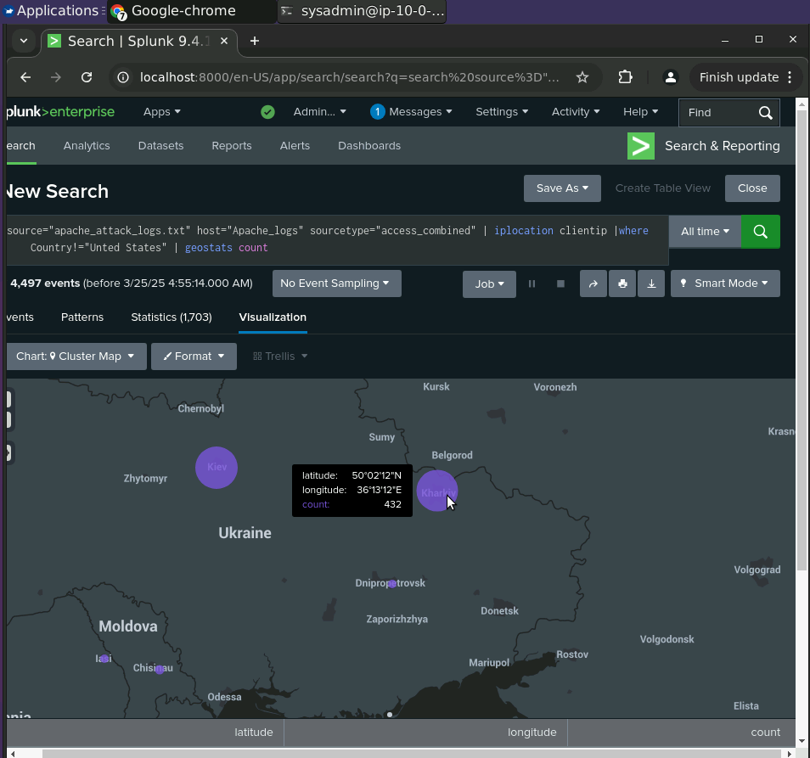
Screenshots of Attack Logs
[

Slide 35
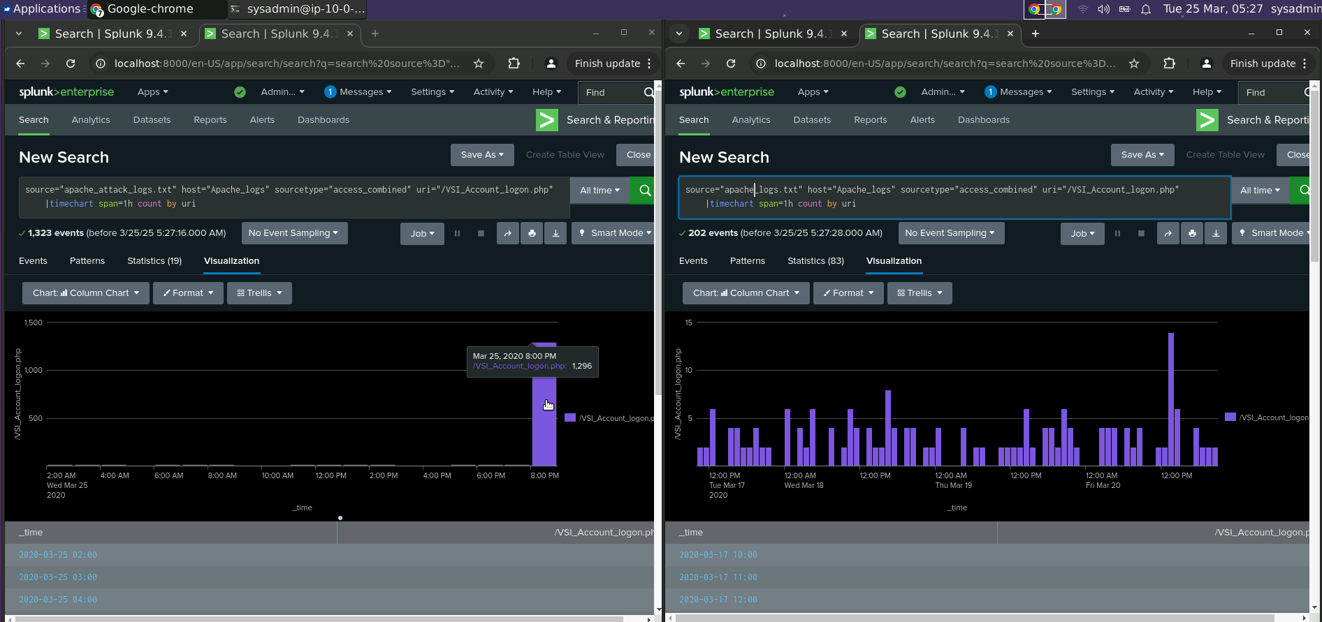
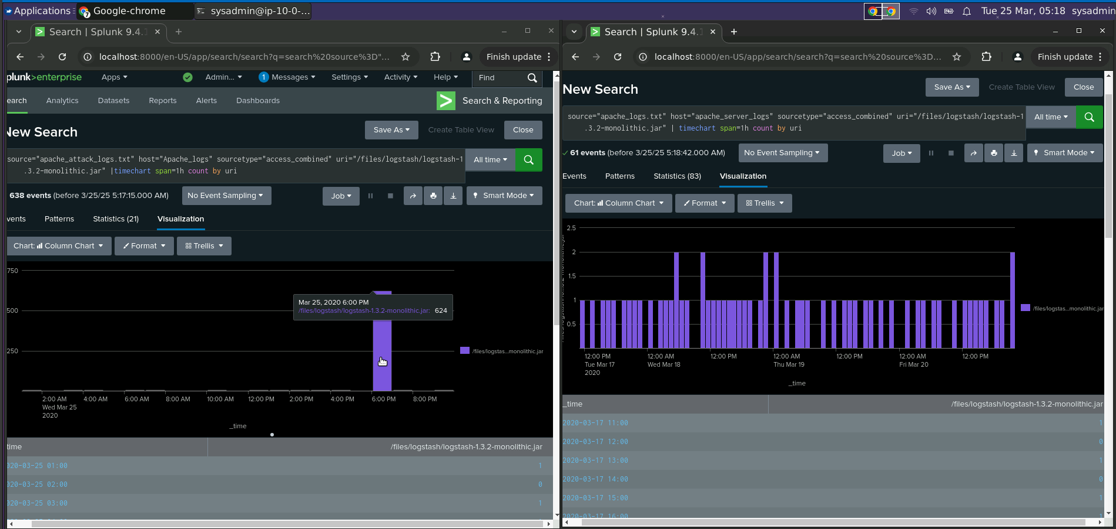
Screenshots of Attack Logs

Slide 36
Summary and Future Mitigations
‹#›

Slide 37
Project 3 Summary
Overall Findings from the Attack:
VSI experienced targeted attacks, with increased failed login attempts and suspicious successful logins, indicating potential credential compromise or brute-force attempts.
Unusual HTTP method activity and increased error responses (404s) pointed to attempts to access non-existent resources.
A significant volume of activity from international regions (e.g., Ukraine) further suggests a coordinated attack.
Future Mitigations to Protect VSI:
Implement Multi-Factor Authentication (MFA)
Strengthen monitoring and alerting
Enforce account lockout policies and rate-limiting
Geo-blocking and CAPTCHA
Regular security audits

